Slide 1
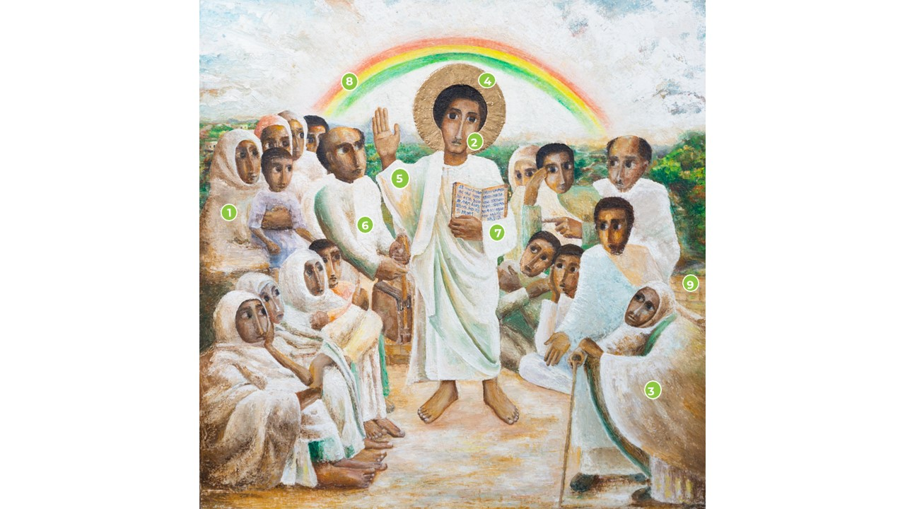
Icon Reflection
Jubilee 2025

Slide 2
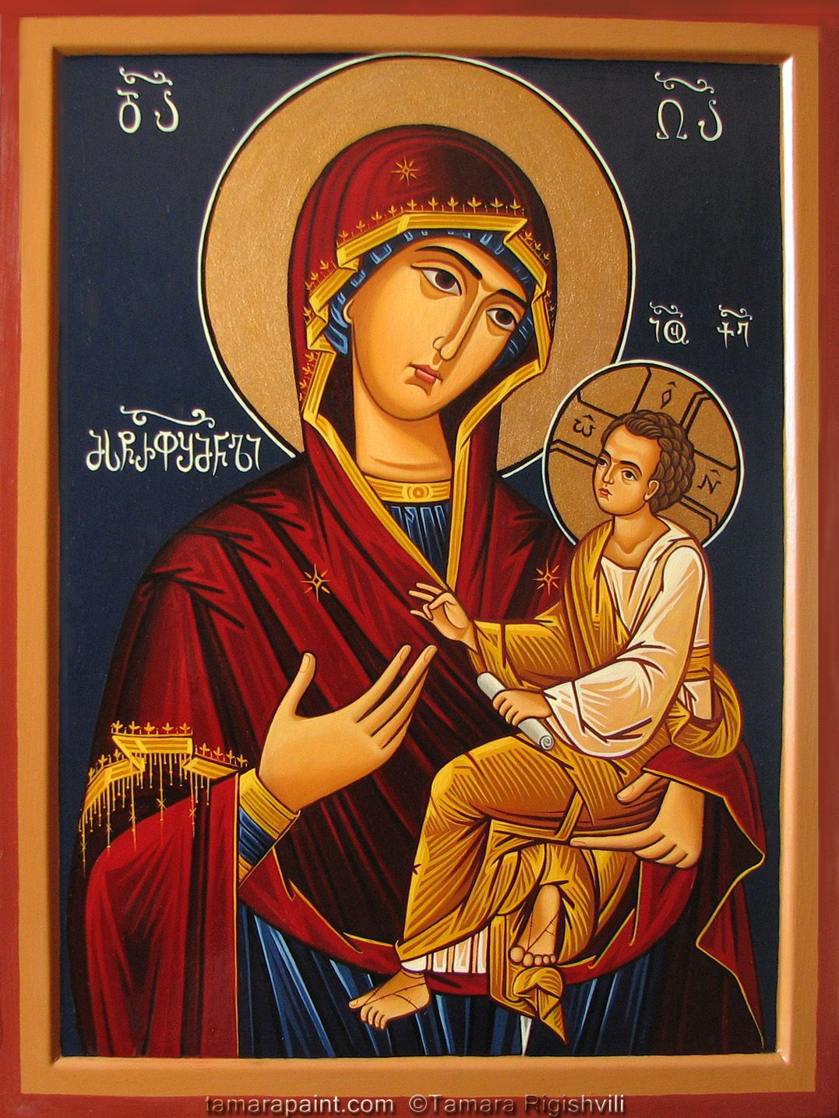
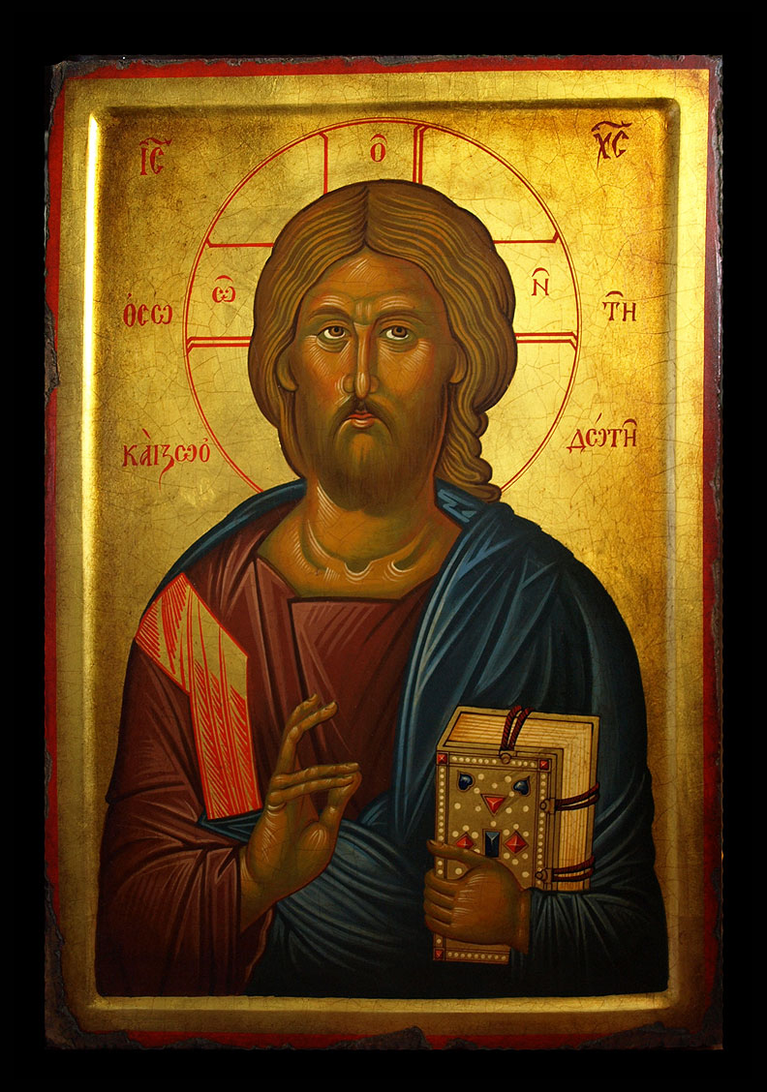
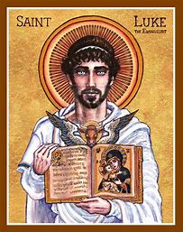
Icons

Slide 3
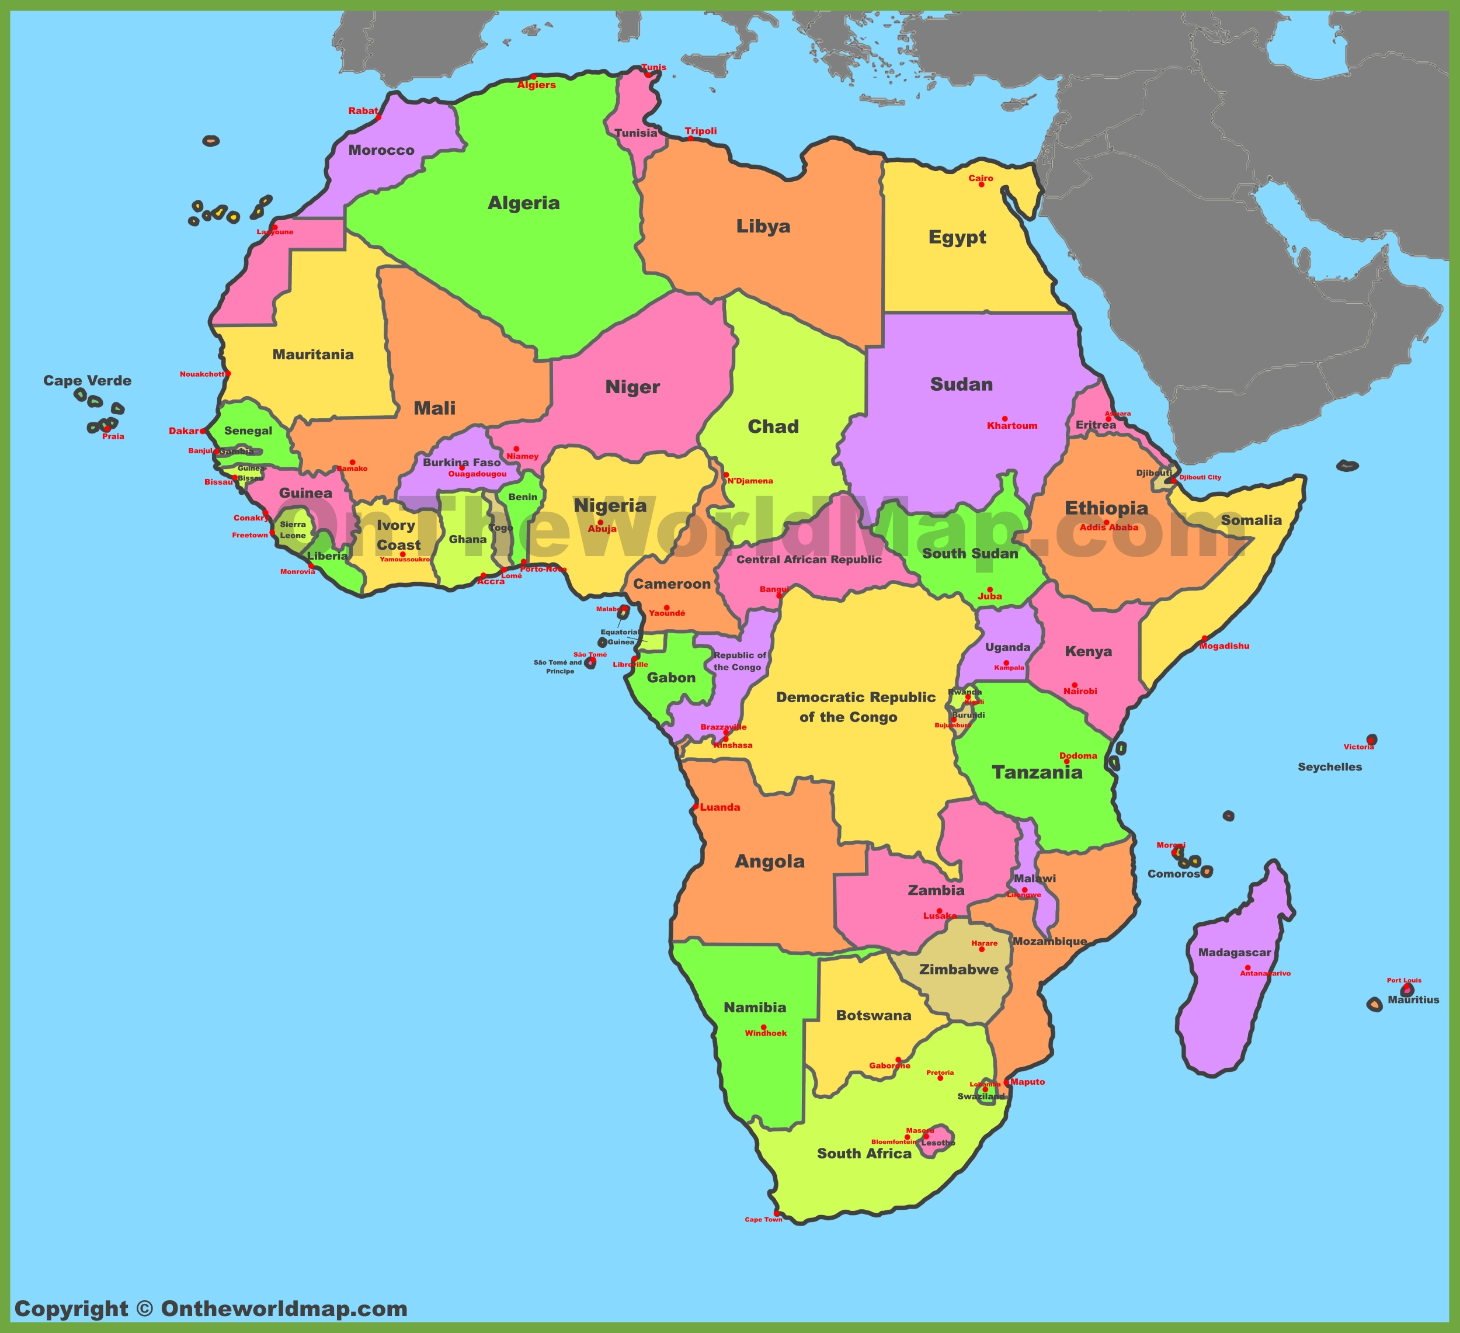
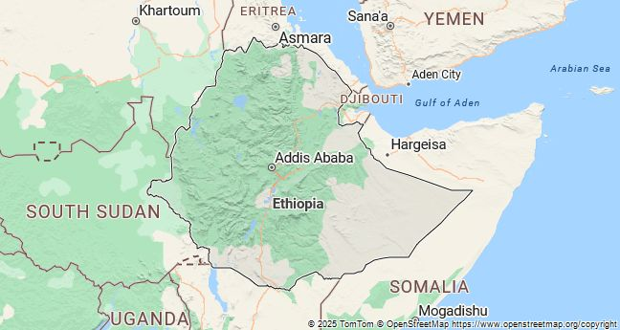
Mulugeta Araya- Ethiopian Artist

Slide 4
The Gospel – Luke 4 16-21

Slide 5
ICON
What do you notice?
What draws you in?
Does the icon tell the story in a different way?

Slide 6
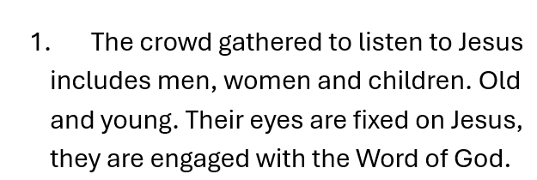

Slide 8
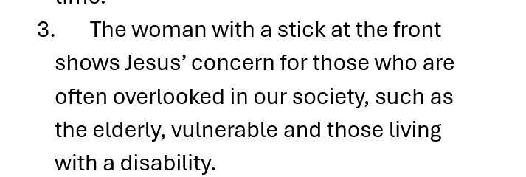

Slide 9
